Slide 1

How to Make Almost Everything
Lecture 07
Architecture and
microcontrollers programming
Brice PARILUSYAN
PhD Student
brice.parilusyan@gmail.com

Slide 2

Course overview
01|
Architecture
02|
AVR-C basic
03|
Communication protocols
04|
Death by practice

Slide 3

Architecture
Internal architecture

Slide 4
1|
Architecture
Internal architecture
What is a micro-controller?
Difference between them
Register
ATmega 328

Slide 5
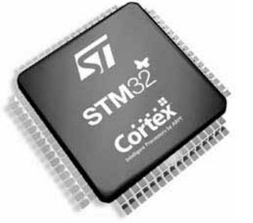
1|
Architecture
What is a micro-controller ?
Definition :
A micro-controller can be comparable to a little stand-alone computer; it is an extremely powerful device, which is able of executing a series of pre-programmed tasks and interacting with extra hardware devices. Several microcontrollers contain a memory to store the program to be executed, and a lot of input/output lines that can be used to act jointly with other devices, like reading the state of a sensor or controlling a motor.

Slide 6
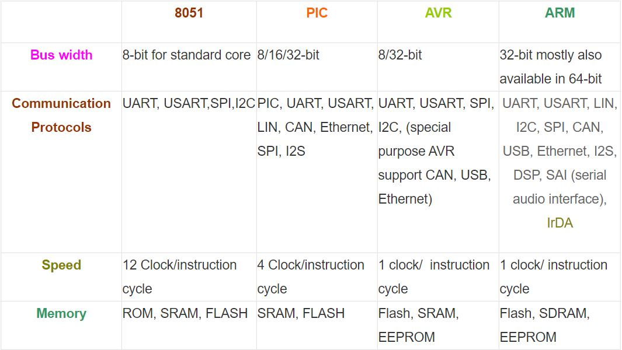
1|
Architecture
Difference between them
Properties :
It exists 4 mains architectures.
8051, developed by Intel
Peripheral Interface Controller (PIC), developed by Microchip
AVR, developed by Atmel
ARM processors, developed by Advanced RISC Machines (ARM)

Slide 7
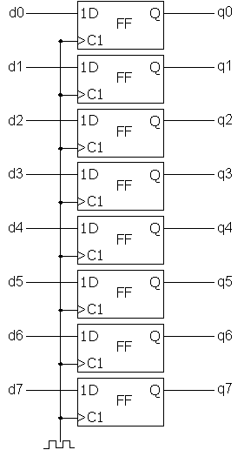
1|
Architecture
Register
Definition :
A register is a memory unit able to store a bit with specific width (8, 16, 32, 64). In a processor, an architectural register store bits who corresponds to instruction for the CPU. Knowing these register allow to control the CPU by tunning the values of the registers.

Slide 8
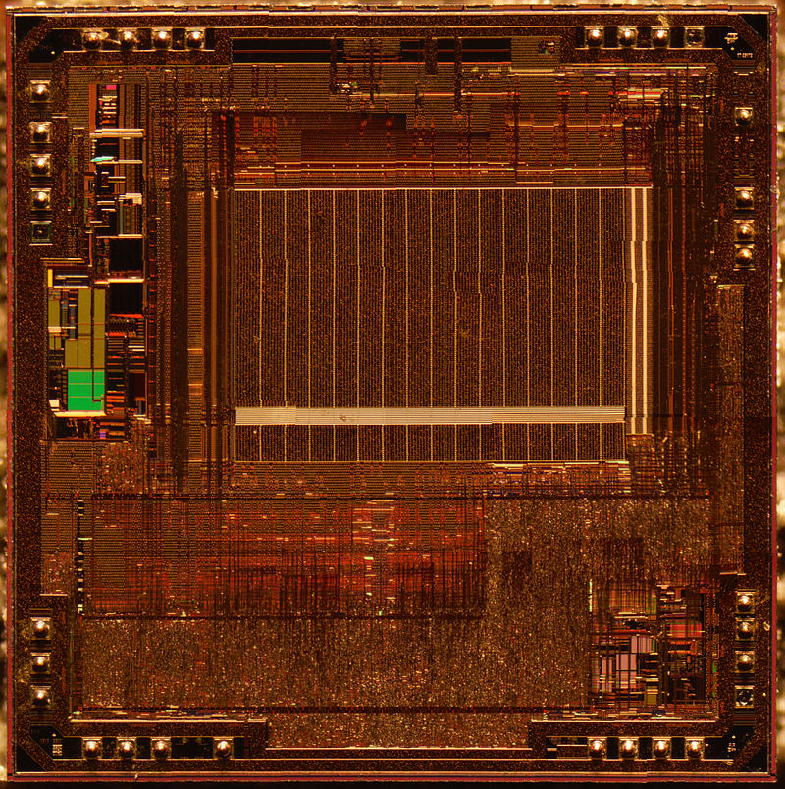
1|
Architecture
ATmega 328
Definition :
The ATmega328 is a single-chip microcontroller created by Atmel in the AVR family (later Microchip Technology acquired Atmel in 2016). It has a modified Harvard architecture 8-bit RISC processor core.

Slide 9

AVR-C Basics
Bitwise manipulation
Interrupts
I/O pins
Timers

Slide 10
2|
AVR-C basic
Bitwise manipulation
Operators
Shifting
Setting
Clearing
Toggling
Exercise

Slide 11
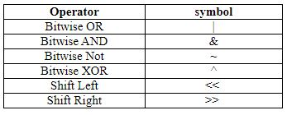
2|
AVR-C basic
Operators
Description :
Operators in AVR are the same as C language, with logic gates operators. Arithmetic operations are made from logic gates, with the arithmetic operators, you are using a logic adder/subtractor/comparator, etc…

Slide 12
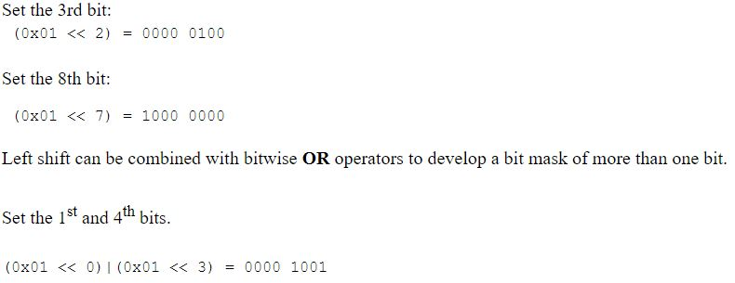
2|
AVR-C basic
Shifting
Description :
Bit shifting is an operation that moves a 1 digit to the corresponding position in a byte. This operation can be combined with other operators.

Slide 13
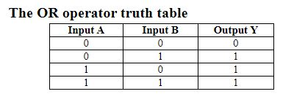

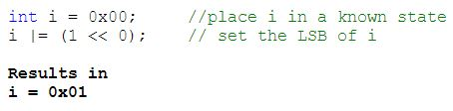
2|
AVR-C basic
Setting
Description :
Setting a bit means turning one or a series of bits to 1. This operation uses an OR operation to be performed.

Slide 14
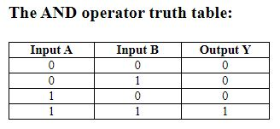


2|
AVR-C basic
Clearing
Description :
Clearing a bit means turning one or a series of bits to 0. This operation uses an AND operation to be performed.

Slide 15
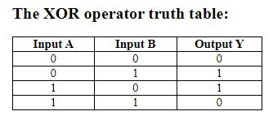
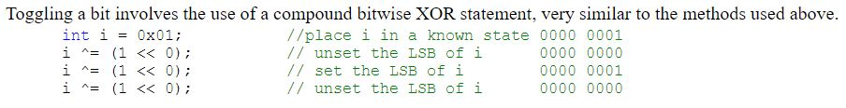
2|
AVR-C basic
Toggling
Description :
Toggling a bit means turning his value to the opposite. This operation uses an XOR operation to be performed.

Slide 16
2|
AVR-C basic
Exercise
Create a variable X equal to 0000 0100
Set X with 0011 0000
Toggle the first bit of X
Clear X with 0001 1101
Set X with 0000 1101 and 0100 0000
Toggle the last bit of X
What is the result in binary of X? Hexadecimal ?

Slide 17
2|
AVR-C basic
I/O pins
Working principle
Setting I/O port

Slide 18
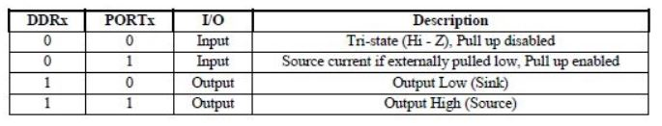
2|
AVR-C basic
Working principle
Description :
I/O ports describe bi-directional ports able to be set as input or output. Each I/O ports have internal pull-up resistors who can be enabled. Each port is multiplexed in multiples ports.
The I/O ports are configurable using 3 registers :
Data Direction Register, DDRx, to define the port as an input or output
Port Data Register, PORTx. In input mode, it allows using a pull-up resistor if the bit is set to 1. In the output, it turns the value of the port to high or low
Port Input Pins Register, PINx, who read the state of the register. Allow getting data from it.

Slide 19
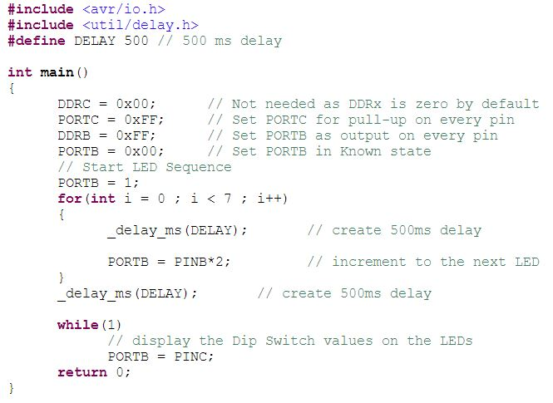
2|
AVR-C basic
Setting I/O ports
Example :
To use the I/O pins, we need to set the DDRx and PORTx registers. Then, we get data with PINx or send them with PORTx if it is set to output.
The code below is wrong in the loop.

Slide 20
2|
AVR-C basic
Interrupts
Working principle
External interrupt

Slide 21
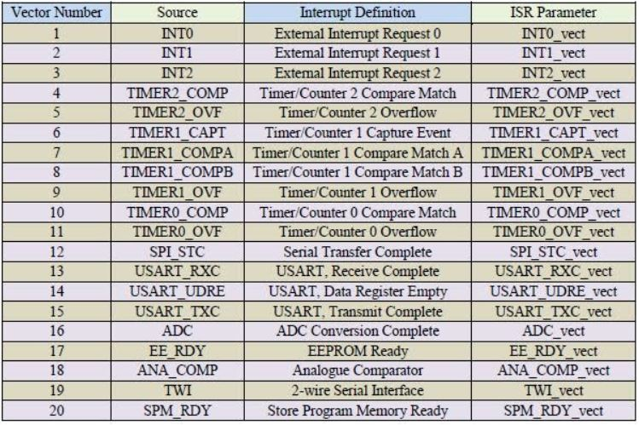
2|
AVR-C basic
Working principle
Description :
Interrupts refer to an expected event activating a specific function of the code. Generally, programs are designed to work In a specific order, but sometimes events need to be managed only when they are happening, with a high priority. Once the interrupt is done, the code restart from where it was before the interrupt.
A micro-controller has a specific set of registers who activate interrupts. When you create an interrupt function, you must use the interrupt flag to define the kind of event you are taking into account.

Slide 22
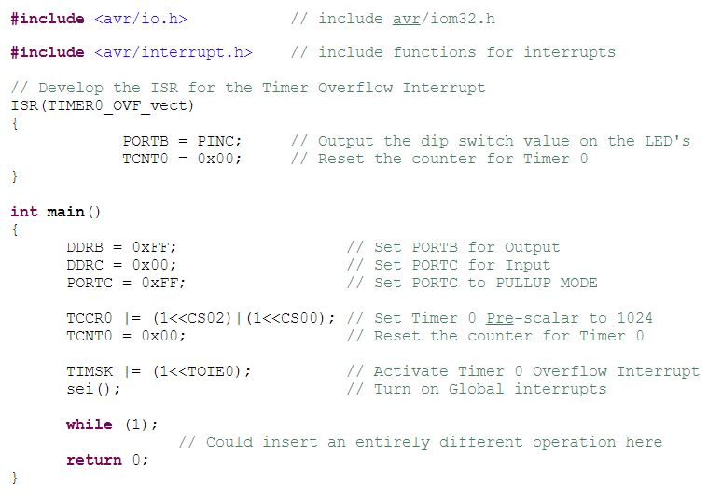
2|
AVR-C basic
Working principle
Example :
In this example, the interrupt function ISR (interrupt service routine) is defined with the flag corresponding to the event use.
The avr/interrupt library needs to be imported.
The function sei() need to be called in the main, before the first interruption. This function enables interrupt in the program.

Slide 23
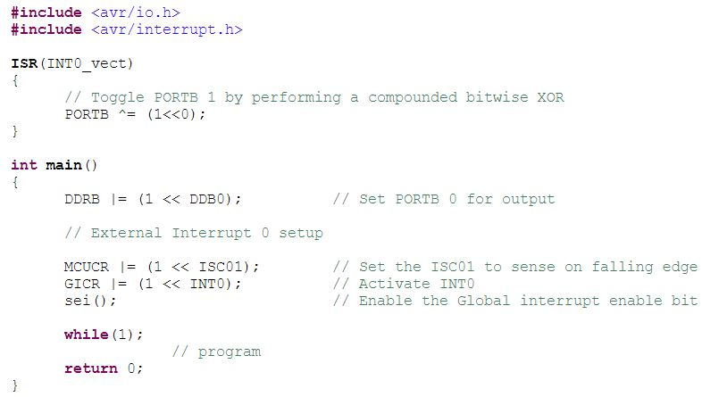
2|
AVR-C basic
External interrupts
Description :
External Interrupts are exactly what their name describes, they are interrupts that have initiating event occurs external to the microcontroller. These interrupts exist in the shape of input pins and can be configured to initiate in one of the four following ways: Low, High, falling, rising

Slide 24
2|
AVR-C basic
Timers
Timers/counter
PWM
Watchdog

Slide 25
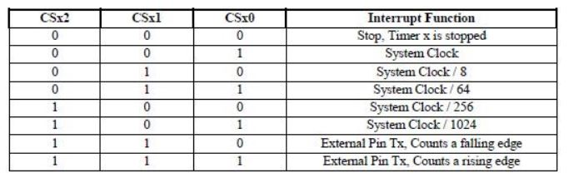
2|
AVR-C basic
Timers/Counter
Description :
Timers give the programmer the ability to measure time, create events at time intervals, and create Pulse Width Modulated (PWM) signals. Timers use the clock pulse as a reference, they have a prescaler operation to reduce their own clock to be more versatile.

Slide 26
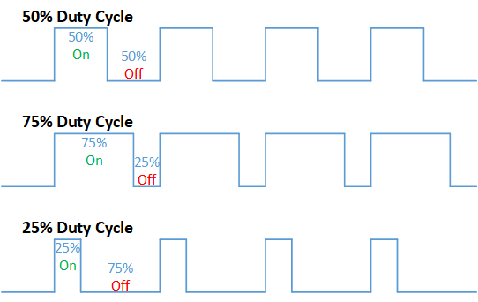
2|
AVR-C basic
PWM
Description :
Pulse-width modulation (PWM), is a method of reducing the average power delivered by an electrical signal, by effectively chopping it up into discrete parts. A PWM can store information by tunning his duty cycle

Slide 27

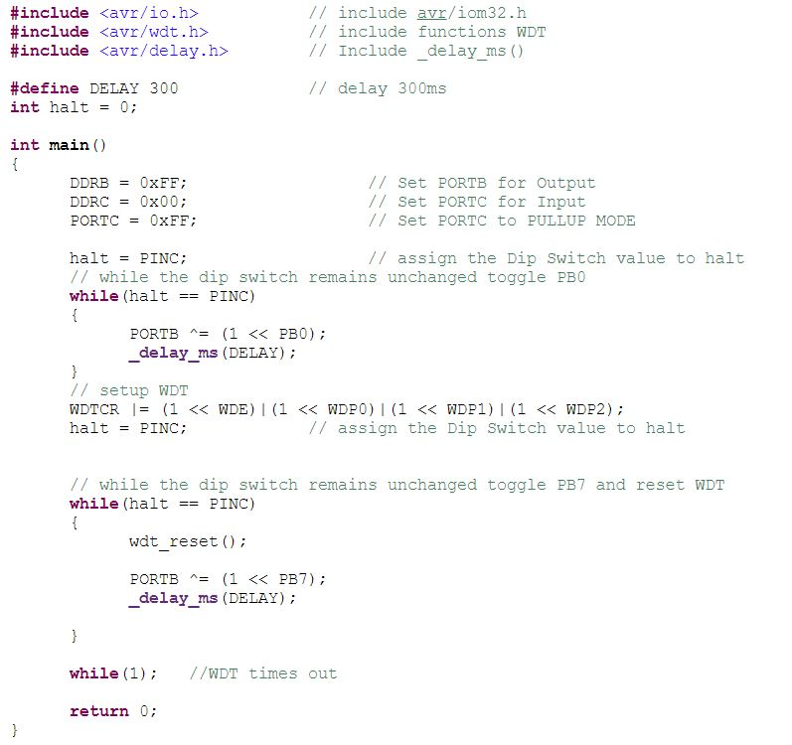
2|
AVR-C basic
Watchdog
Description :
The watchdog timer is a peripheral which performs an interrupt reset if the timer is allowed to timeout. The purpose of developing your code with the watchdog timer is to incorporate code that continually resets the timer and ensures that under correct operation the timer will never timeout. Therefore if the processor hangs or the program gets confused the watchdog timer will timeout and force an interrupt reset, which will restart your entire program from the beginning of main().

Slide 28

Communication protocols
Communications

Slide 29
3|
Com protocols
Communications
I2C
SPI
USART

Slide 30
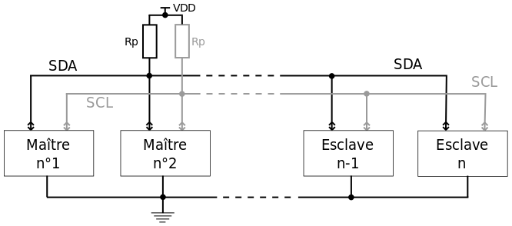
3|
Com protocols
I2C
Definition :
I2C (Inter-Integrated Circuit), pronounced I-squared-C, is a synchronous, multi-master, multi-slave, packet switched, single-ended, serial communication bus. This system uses only two wires, SDA for data and SCL for the clock. With one component as a parent, you can communicate with numerous child-components.

Slide 31
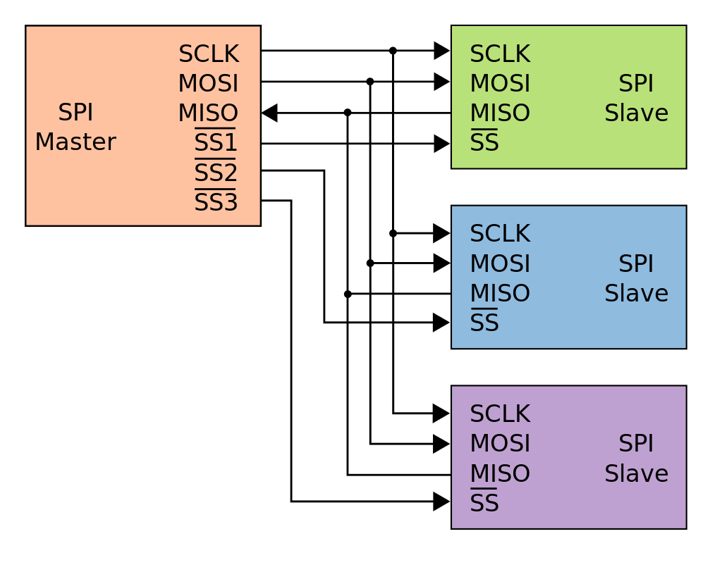
3|
Com protocols
SPI
Definition :
The Serial Peripheral Interface (SPI) is a synchronous serial communication interface specification used for short-distance communication, primarily in embedded systems.
It needs to have 4 wires by component, with one specific to it. But the communication speed is extremely high.

Slide 32
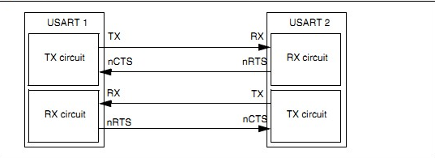
3|
Com protocols
USART
Definition :
The Universal Synchronous and Asynchronous and Receiver and Transmitter (USART) is a peripheral provided for serial communications. USART is very useful as it can be configured to communicate with various other devices including Personal Computers; this is easily achieved using an RS-232 configuration and programs such as hyper terminal on a Windows platform or CuteCom and gTerm for a Linux platform.

Slide 33

Death by practice
Program Burning
I/O pins
Interrupts
USART
Timer
Trial by wombat !

Slide 34
4|
Practice
Program Burning
Cross compile it:
avr-gcc -Wall -g -Os -mmcu=atmega328p -o main.bin main.c
Generate HEX file:
avr-objcopy -j .text -j .data -O ihex main.bin main.hex
Burn it:
avrdude -p atmega328p -c arduino -U flash:w:main.hex:i -F -P usb

Slide 35
4|
Practice
I/O pins
Exercise :
Set the pin b2 to output and pin c3 to input. When a signal is sent to c3, copy it on b2.
Add a Led to b2 to see the result.

Slide 36
4|
Practice
Interrupts
Exercise :
Generate an external interrupt to turn on a Led when a signal is sent to an input pin.

Slide 37
4|
Practice
USART
Exercise :
Enable a serial communication with your computer and send the input information of a pin.
Then, allow to send a data from your computer to switch on a Led

Slide 38
4|
Practice
Timers
Exercise :
Realize a PWM with a duty cycle of 75%

Slide 39

4|
Practice
Trial by wombat !

